Slide 1

Unlocking Sales Performance: The BMW Sales Analytics Dashboard
This presentation outlines the development and impact of the BMW Sales Analytics Dashboard, a cutting-edge business intelligence solution designed to provide comprehensive insights into global sales performance. Leveraging Microsoft Power BI, this dashboard empowers BMW management with actionable data for strategic decision-making.

Slide 2






Project Team Members
This project was brought to fruition through the dedicated efforts and collaborative spirit of a talented team, each contributing their unique expertise to develop the BMW Sales Analytics Dashboard.
Hamza Ahmed
Riam Arbab
Houreya Ayman
Walaa Hassan
Ahmed Mamdoh
Micaek Mark

Slide 3


Project Overview
Transforming Sales Data into Strategic Insights
1
2
Project Title
Technology
BMW Sales Analytics Dashboard
Microsoft Power BI for interactive visualisations and analysis.
3
4
Data Source
Goal
Cleaned and transformed Excel data .
To furnish BMW management with a clear, interactive tool for understanding global sales performance and enhancing business decisions.

Slide 4





Comprehensive Visibility: What the Dashboard Offers
Full Visibility of BMW Car Sales
A complete overview of global sales figures, providing a holistic view of market penetration and performance.
Analysis by Key Dimensions
Detailed breakdown by region, model, fuel type, and transmission for granular insights.
Comparison of Key KPIs
Tracking of essential metrics: Units Sold, Total Sales, and Average Price, offering benchmarks for performance evaluation.
Identification of High-Demand Areas
Pinpointing top-performing models and markets to capitalise on successful strategies.
Insight into Customer Preferences
Understanding pricing patterns and customer choices to refine product offerings and marketing efforts.

Slide 5

Chapter 2: Business Challenges
Overcoming Prior Sales Reporting Limitations
Before the BMW Sales Analytics Dashboard was introduced, the sales team struggled with major issues that made it difficult to make informed decisions and fully understand the market. These problems showed the clear need for a unified, flexible business intelligence solution.
Lack of a Centralised Sales View
Sales data was fragmented across multiple sources, preventing a unified overview of performance.
Difficulty Comparing Regions and Models
Management struggled to quickly assess and compare the performance of different regions and car models.
Time-Consuming Manual Reporting
Manual report generation led to delays, slowing down timely responses to market shifts.
Absence of Visual Insights
The lack of interactive visual tools made it challenging to discern trends, patterns, and performance fluctuations.
Limited Opportunity/Issue Detection
Without advanced BI tools, identifying sales growth opportunities or addressing emerging issues was nearly impossible.

Slide 6
Chapter 3: The Solution
Introducing the BMW Sales Analytics Dashboard
The BMW Sales Analytics Dashboard is an interactive Power BI solution carefully designed to address the previous reporting inefficiencies and empower strategic decision-making.
Visualises Sales Trends
Compares Performance
Tracks sales performance over time, revealing growth trajectories and seasonal fluctuations.
Enables direct comparison across regions, models, and categories, highlighting strengths and areas for improvement.
Highlights Best-Selling Series
Segments by Fuel & Transmission
Quickly identifies top-performing car series to inform inventory and marketing strategies.
Offers insights into performance based on fuel type and transmission preferences.

Slide 7

Impact of the Solution
The implementation of the BMW Sales Analytics Dashboard has brought about transformative benefits across the organisation.
Faster, Clearer Business Decisions
Real-time data access empowers management to make informed choices with unprecedented speed and clarity.
Automated Reporting
Eliminates time-consuming manual processes, freeing up resources for more strategic tasks.
Real-Time Sales Visibility
Continuous updates provide an up-to-the-minute overview of sales performance, critical for agile responses.
Enhanced Market Demand Understanding
Deeper insights into customer behaviour and market trends enable proactive adjustments to strategy.

Slide 8
Chapter 4: How It Works
The Dashboard's Data Pipeline
The BMW Sales Analytics Dashboard operates through a robust and carefully designed data pipeline, ensuring accuracy, relevance, and accessibility of sales insights.
1. Data Collection
2. Data Cleaning (Power Query)
Sales data is systematically extracted from BMW’s central database, ensuring comprehensive and up-to-date information.
Utilising Power Query, raw data undergoes rigorous cleaning: duplicates are removed, missing values are fixed, and key attributes like engine size and mileage are standardised. Model and region values are also validated for consistency.
3. Data Modelling
4. DAX Measures Creation
The cleaned data is then structured creating clear relationships between tables to optimise query performance and analytical capabilities.
Key Performance Indicators (KPIs) are calculated using Data Analysis Expressions (DAX), including Total Sales, Total Units Sold, Average Price, Year-Over-Year Growth, and Fuel & Transmission Shares.
5. Dashboard Visualisation
6. User Interaction
Data is brought to life using a variety of Power BI visuals, such as bar charts, line charts, cards, slicers, maps, and model comparison views, designed for maximum clarity and impact.
Management can dynamically filter data by region, model, year, transmission, fuel type, colour, mileage, and engine size, allowing for bespoke analysis tailored to specific inquiries.

Slide 9
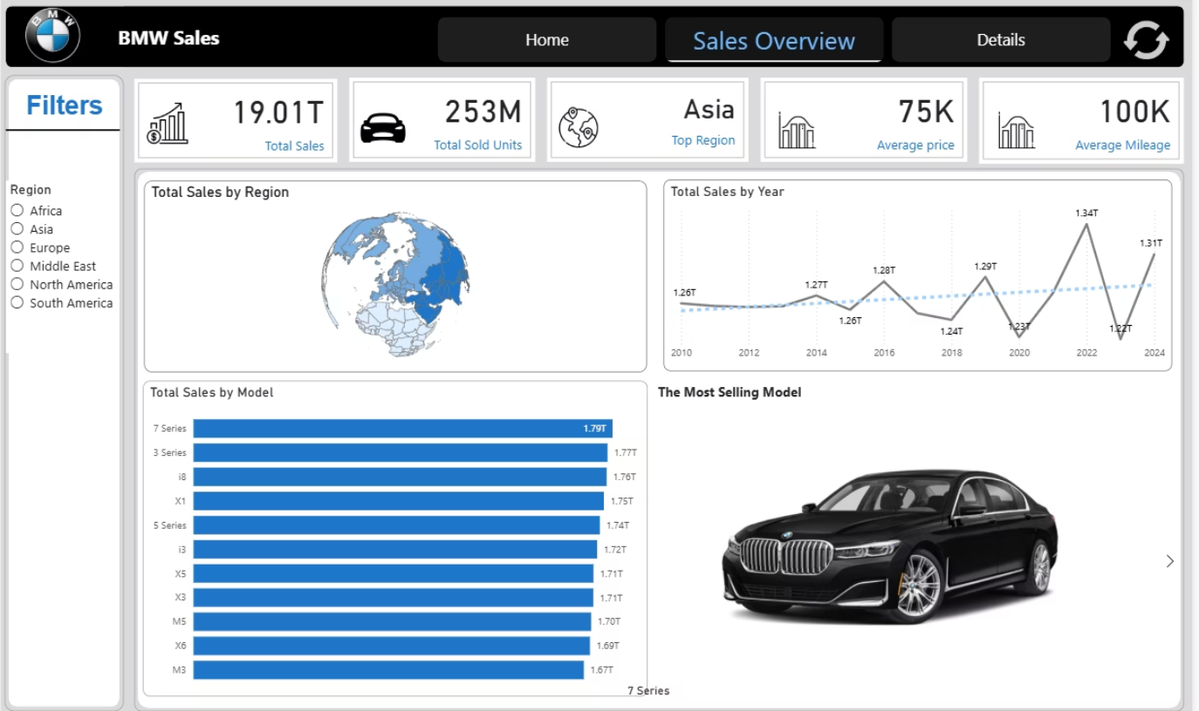
Interactive Filtering for Deeper Analysis
The dashboard's interactive features provide unparalleled flexibility, allowing users to drill down into specific data segments.
Region & Model
Target specific geographical markets or car models to understand their unique performance.
Year & Quarter
Analyize sales trends over different time periods, identifying seasonality and growth patterns.
Transmission & Fuel Type
Evaluate the popularity of different powertrain configurations and fuel preferences.
Color, Mileage, Engine Size
Gain nuanced insights into customer aesthetic and performance preferences.

Slide 10
Chapter 5: Conclusion
Transforming Raw Data into Actionable Intelligence
The BMW Sales Dashboard represents a significant leap forward in leveraging data for strategic advantage, turning raw sales figures into meaningful, actionable insights.
Clear Performance Visualisation
Identification of Key Drivers
Management can clearly discern where BMW excels, allowing for targeted resource allocation.
High-selling models and regions are effortlessly identified, informing production and marketing focus.
Understanding Customer Preferences
Accelerated & Accurate Decisions
Insights into pricing and mileage trends provide a deeper understanding of what customers truly value.
Business decisions are now faster and more precise, driven by empirical data rather than conjecture.

Slide 11


Future Outlook and Strategic Advancement
This BI solution significantly improves BMW’s ability to analyse sales, understand market behaviour, and plan future strategies based on real data—not assumptions.
The current dashboard is merely the foundation. Future iterations can incorporate advanced features such as predictive analytics for sales forecasting, deeper market segmentation, and integration with other data sources for a 360-degree view of the customer journey. This continuous evolution will ensure BMW remains at the forefront of data-driven decision-making in the automotive industry.
The dashboard can be expanded to forecasting and deeper analytics in the future, providing even greater strategic value.

Slide 12

Thank You
We extend our sincere gratitude to Dr. Ayman Abelgawad for his invaluable contributions and leadership in bringing the BMW Sales Analytics Dashboard to fruition. His expertise was crucial to our success.

